Slide 1
FIR Filter Design

Slide 2
Why FIR Filter Design?
Designing a digital low pass filter (as a very important digital signal processor) using FIR filters have several advantages:
The phase response can be exactly linear.
They are relatively easy to design since there are no stability problems.
They are efficient to implement.
The DFT can be used in their implementation.

Slide 3
Why LINEAR-PHASE FIR FILTERS?
Especially going with those FIR filters which have “linear-phase response” is very popular, because:
design problem contains only real arithmetic and not complex arithmetic.
linear-phase filters provide no delay distortion and only a fixed amount of delay.
for the filter of length M (or order M − 1) the number of operations are of the order of M/2.

Slide 4
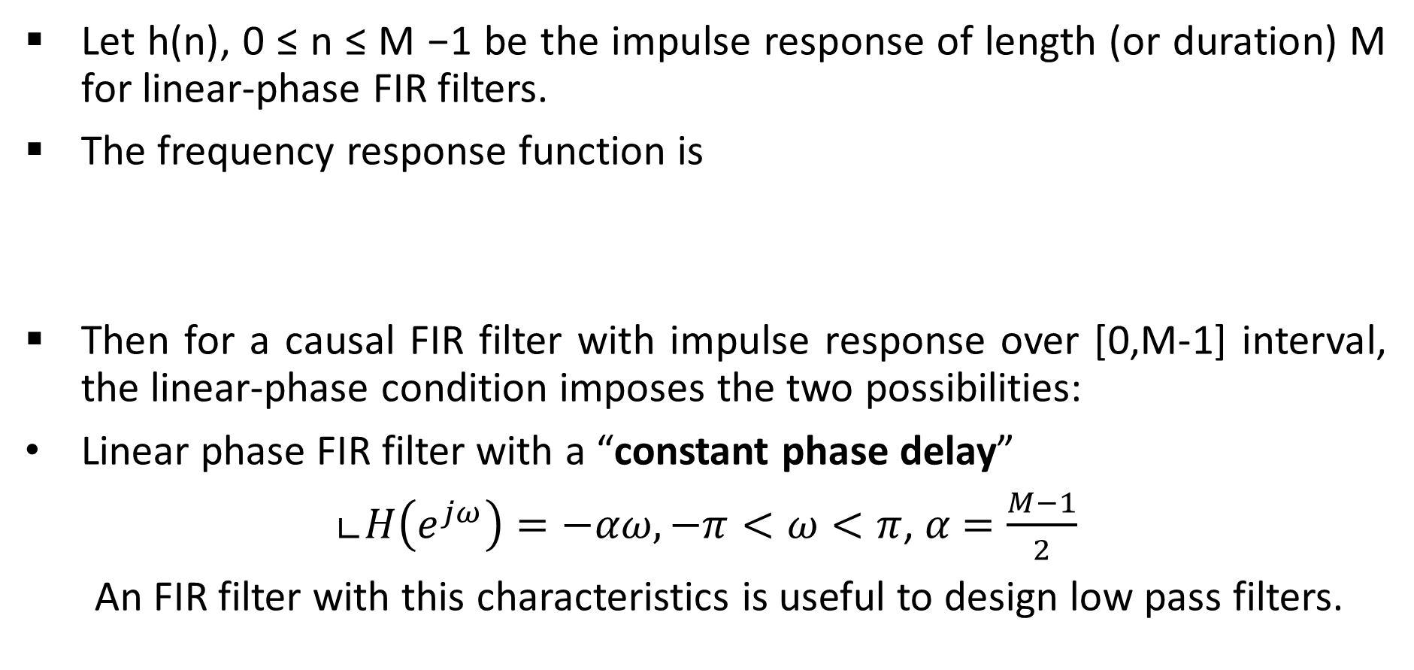
IMPULSE RESPONSE of a Linear Phase FIR Filter
Let h(n), 0 ≤ n ≤ M −1 be the impulse response of length (or duration) M for linear-phase FIR filters.
The frequency response function is
Then for a causal FIR filter with impulse response over [0,M-1] interval, the linear-phase condition imposes the two possibilities:
Linear phase FIR filter with a “constant phase delay”
∟$H\left(e^{jω}\right)=−αω, −π<ω<π$, $α$ $=\frac{M−1}{2}$
An FIR filter with this characteristics is useful to design low pass filters.

Slide 5
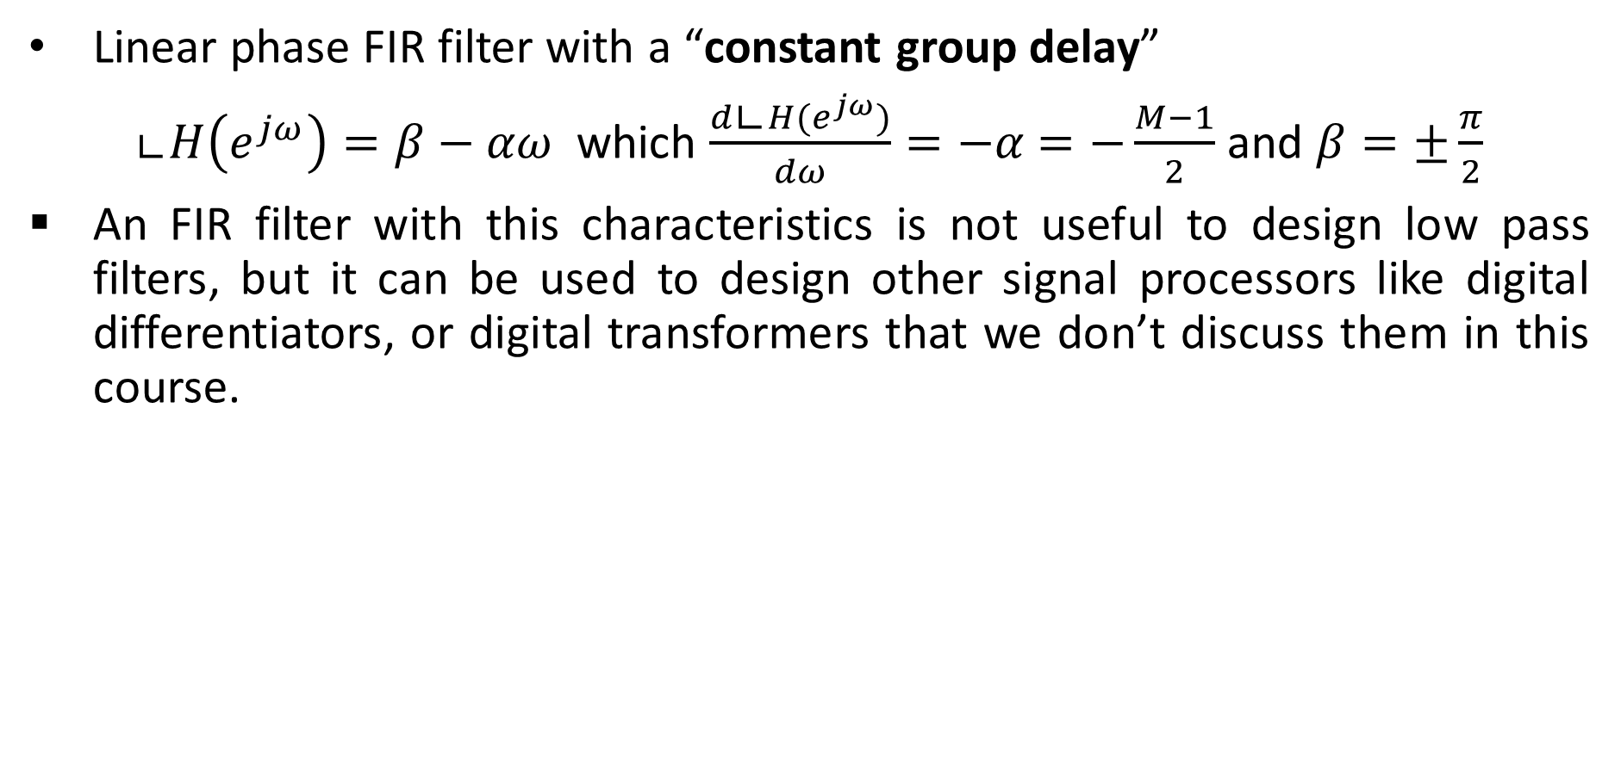
IMPULSE RESPONSE of a Linear Phase FIR Filter
Linear phase FIR filter with a “constant group delay”
∟$H\left(e^{jω}\right)=β−αω$ which $\frac{d\text{∟}H(e^{jω})}{dω}=−α$ $=−\frac{M−1}{2}$ and $β=±\frac{π}{2}$
An FIR filter with this characteristics is not useful to design low pass filters, but it can be used to design other signal processors like digital differentiators, or digital transformers that we don’t discuss them in this course.

Slide 6
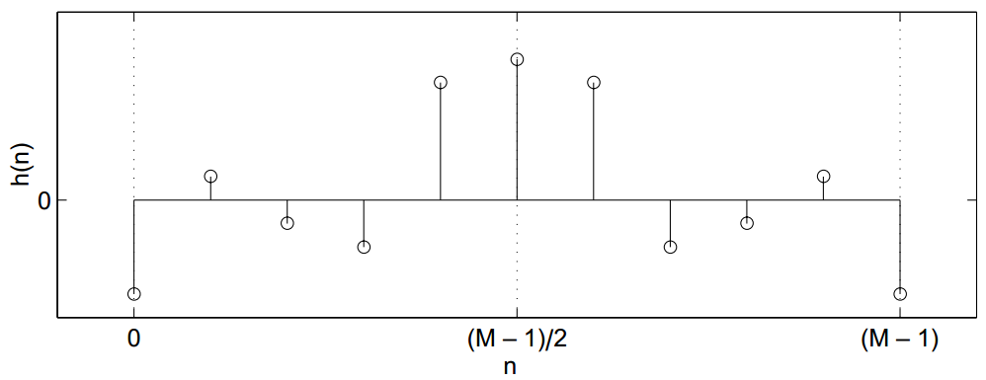
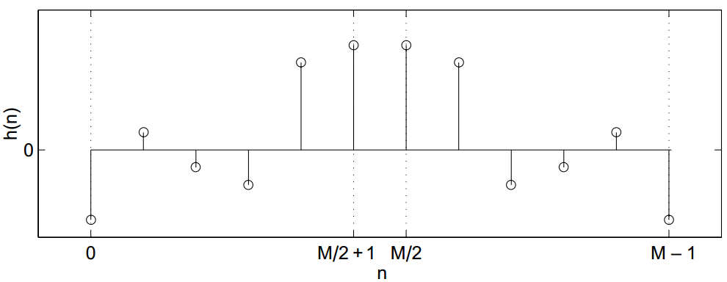

IMPULSE RESPONSE of a Linear Phase FIR Filter with constant phase delay
M: odd In this case, $α{=(M−1)}/2$ is an integer.
M: even In this case, $α{=(M−1)}/2$ is not an integer.

Slide 7
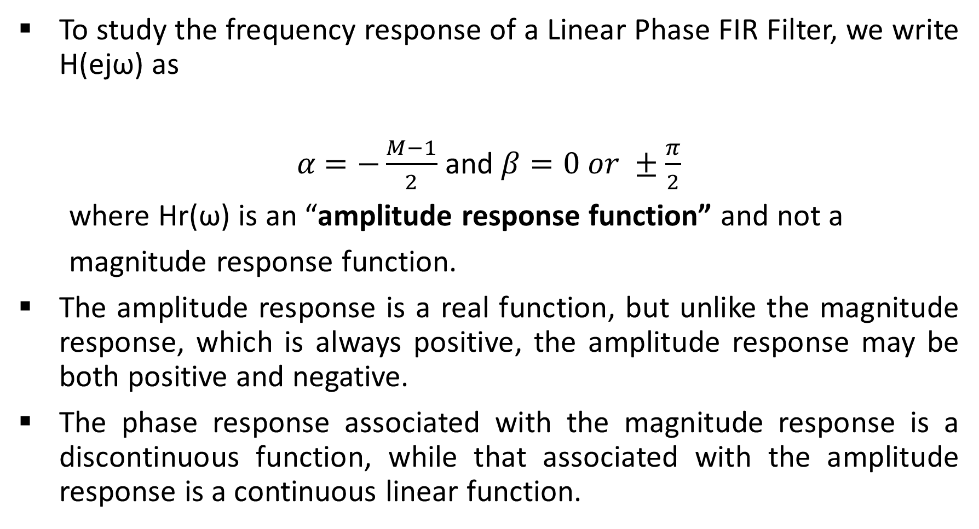
Frequency Response of a Linear Phase FIR Filter
To study the frequency response of a Linear Phase FIR Filter, we write H(ejω) as
$α$ $=−\frac{M−1}{2}$ and $β=0 or ±\frac{π}{2}$
where Hr(ω) is an “amplitude response function” and not a
magnitude response function.
The amplitude response is a real function, but unlike the magnitude response, which is always positive, the amplitude response may be both positive and negative.
The phase response associated with the magnitude response is a discontinuous function, while that associated with the amplitude response is a continuous linear function.

Slide 8
Frequency Response of a Linear Phase FIR Filter
EXAMPLE Let the impulse response be h(n) = {1↑, 1, 1}. Determine and draw frequency responses.
Solution The frequency response function is
From this the magnitude and the phase responses are
since cos ω can be both positive and negative.
In this case the phase response is piecewise linear.

Slide 9
Frequency Response of a Linear Phase FIR Filter
On the other hand, the amplitude and the corresponding phase responses are
In this case the phase response is truly linear.

Slide 10
Frequency Response of a Linear Phase FIR Filter
These responses are shown in the following Figure.

Slide 11
Frequency Response of a Linear Phase FIR Filter
When the cases of symmetry are combined with odd and even M, we obtain two types of linear-phase FIR filters as follows:
Type-1 linear-phase FIR filter: Symmetrical impulse response, M odd In this case β = 0, α = (M − 1)/2 is an integer, and h(n) = h(M − 1 − n), 0 ≤ n ≤ M − 1. Then we can show that
where sequence a(n) is obtained from h(n) as
a(0) = h(M − ½), a(n) = 2h((M − 1)/2− n), 1 ≤ n ≤ (M − 1)/2

Slide 12
Frequency Response of a Linear Phase FIR Filter
Type-2 linear-phase FIR filter: Symmetrical impulse response, M even In this case again β = 0, h(n) = h(M−1−n), 0 ≤ n ≤ M−1, but α = (M−1)/2 is not an integer. Then we can show that
where b(n) = 2h(M/2− n), n= 1, 2, . . . ,M/2
Note: At ω = π we get
regardless of b(n) or h(n). Hence, “we cannot use this type (i.e.,
symmetric h(n), M even) for highpass or bandstop filters”.

Slide 13
Frequency Response of a Linear Phase FIR Filter
EXAMPLE Let h(n) = {−4↑, 1,−1,−2, 5, 6, 5, -2, -1, 1, -4}. Determine the amplitude response Hr (ω).
Solution Since M = 11, which is odd, and since h(n) is symmetric
about α = (11 − 1)/2 = 5, this is a Type-1 linear-phase FIR filter. we
have
a(0) = h (α) = h(5) = 6, a(1) = 2h(5 − 1) = 10, a(2) = 2h(5 − 2) = −4
a (3) = 2h (5 − 3) = −2, a(4) = 2h (5 − 4) = 2, a(5) = 2h (5 − 5) = −8 and
Hr(ω) = a(0)+a(1) cos ω +a(2) cos 2ω +a(3) cos 3ω +a(4) cos 4ω +a(5)
cos 5ω = 6 + 10cos ω − 4 cos 2ω − 2 cos 3ω + 2cos 4ω − 8 cos 5ω

Slide 14
Octave Implementation, Hr-Type1

Slide 15
Octave Implementation, Hr-Type2

Slide 16
WINDOW DESIGN TECHNIQUES
The basic idea behind the window design is to choose a proper ideal frequency-selective filter (which always has a noncausal, infinite-duration impulse response) and then to truncate (or window) its impulse response to obtain a linear-phase and causal FIR filter. Therefore the emphasis in this method is on selecting an appropriate windowing function and an appropriate ideal filter.
We will denote an ideal frequency-selective filter by Hd(ejω), which has a unity magnitude gain and linear-phase characteristics over its passband, and zero response over its stopband.
An ideal LPF of bandwidth ωc < π is given by
where ωc is also called the cutoff frequency, and α is called the
sample delay.

Slide 17
WINDOW DESIGN TECHNIQUES
The impulse response of this filter is of infinite duration and is given by
Note that hd(n) is symmetric with respect to α, a fact useful for linear phase FIR filters. (Remember anti-symmetric impulse responses are not a good choice for low pass filters.)

Slide 18
WINDOW DESIGN TECHNIQUES
To obtain an FIR filter from hd(n), one has to truncate hd(n) on both
sides.
To obtain a causal and linear-phase FIR filter h(n) of length M, we must have
This operation is called “windowing.” In general, h(n) can be thought of as being formed by the product of hd(n) and a window function w(n) as follows:
h(n) = hd(n)w(n)
Where

Slide 19
WINDOW DESIGN TECHNIQUES
Depending on how we define w(n), we obtain different window designs. For example, in
which is the “rectangular window”.
In the frequency domain the causal FIR filter response H(ejω) is given by the periodic convolution of Hd(ejω) and the window response W(ejω); that is,

Slide 20
WINDOW DESIGN TECHNIQUES
This is shown pictorially in the following Figure for a typical window response,

Slide 21
WINDOW DESIGN TECHNIQUES
Then we have the following observations:
Since the window w(n) has a finite length equal to M, its response has a peaky “main lobe” whose width is proportional to 1/M, and has “side lobes” of smaller heights.
The mentioned periodic convolution produces a smeared version of the ideal response Hd(ejω).
The main lobe produces a transition band in H(ejω) whose width is responsible for the transition width. This width is then proportional to 1/M. The wider the main lobe, the wider will be the transition width.
The side lobes produce ripples that have similar shapes in both the passband and stopband.

Slide 22
Basic window design idea
For the given filter specifications, choose the filter length M and a window function w(n) for the narrowest main lobe width and the smallest side lobe attenuation possible.
From the last mentioned observation, we note that the passband tolerance δ1 and the stopband tolerance δ2 cannot be specified independently.
We generally take care of δ2 alone, which results in δ2 = δ1.
We now briefly describe various well-known window functions.
We will use the rectangular window as an example to study their performances in the frequency domain.

Slide 23
RECTANGULAR WINDOW
This is the simplest window function but provides the worst performance from the viewpoint of stopband attenuation. It was defined earlier by
Its frequency response function is
which is the amplitude response.

Slide 24
RECTANGULAR WINDOW
From the mentioned convolution, the actual amplitude response Hr (ω) is given by
This implies that the running integral of the window amplitude response (or accumulated amplitude response) is necessary in the accurate analysis of the transition bandwidth and the stopband attenuation.
The following Figure shows the rectangular window function w (n), its amplitude response W(ω), the amplitude response in dB, and the accumulated amplitude response in dB.

Slide 25
RECTANGULAR WINDOW

Slide 26
RECTANGULAR WINDOW
From the observation of plots in this Figure, we can make several observations:
The amplitude response Wr (ω) has the first zero at ω = ω1, where
ω1M/2= π or ω1=2π/M
Hence the width of the main lobe is 2ω1 = 4π/M. Therefore the
approximate transition bandwidth is 4π/M.
The magnitude of the first side lobe (which is also the peak side lobe magnitude) is approximately at ω = 3π/M and is given by
Comparing this with the main lobe amplitude, which is equal to M,
the peak side lobe magnitude is 2/3π= 21.22% ≡ 13 dB of the main
lobe amplitude.

Slide 27
RECTANGULAR WINDOW
The accumulated amplitude response has the first side lobe magnitude at 21 dB. This results in the minimum stopband attenuation of 21 dB irrespective of the window length M.
Using the minimum stopband attenuation, the transition bandwidth can be accurately computed. It is shown in the accumulated amplitude response plot in the Figure. This computed exact transition bandwidth is
ωs − ωp =1.8π/M
which is less than half the approximate bandwidth of 4π/M.

Slide 28
RECTANGULAR WINDOW
Clearly, this is a simple window operation in the time domain and an easy function to analyze in the frequency domain. However, there are two main problems:
First, the minimum stopband attenuation of 21 dB is insufficient in practical applications.
Second, the rectangular windowing being a direct truncation of the infinite length hd(n), it suffers from the “Gibbs phenomenon”. If we increase M, the width of each side lobe will decrease, but the area under each lobe will remain constant. Therefore, the relative amplitudes of side lobes will remain constant, and the minimum stopband attenuation will remain at 21 dB. This implies that all ripples will bunch up near the band edges.
Since the rectangular window is impractical in many applications, we consider other fixed window functions that provide a fixed amount of attenuation.

Slide 29
HANN WINDOW
This is a raised cosine window function given by
This window and its frequency-domain responses are shown in the following Figure.

Slide 30
HANN WINDOW

Slide 31
HAMMING WINDOW
This window is similar to the Hann window except that it has a small amount of discontinuity and is given by
This window and its frequency-domain responses are shown in the following Figure.

Slide 32
HAMMING WINDOW

Slide 33
KAISER WINDOW
This is an adjustable window function that is widely used in practice. The window function is due to J. F. Kaiser and is given by
where I0[ · ] is a complicated Bessel function.
This window can provide different transition widths for the same M, which is something other fixed windows lack. For example,
if β = 5.658, then the transition width is equal to 7.8π/M, and the
minimum stopband attenuation is equal to 60 dB. This is shown in
the following Figure.
if β = 4.538, then the transition width is equal to 5.8π/M, and the
minimum stopband attenuation is equal to 50 dB.

Slide 34
KAISER WINDOW

Slide 35
KAISER WINDOW
Hence, the performance of this window is comparable to that of the Hamming window.
In addition, the Kaiser window provides flexible transition bandwidths.
Due to the complexity involved in the Bessel functions, the design equations for this window are not easy to derive. Fortunately, Kaiser has developed the following expressions:

Slide 36
Octave Implementation
OCTAVE provides several functions to implement window functions discussed above.
A brief description of these functions follow:
w=boxcar(M) returns the M-point rectangular window function in array w.
w=hann(M) returns the M-point Hann window function in array w.
w=hamming(M) returns the M-point Hamming window function in array w.
w=kaiser(M,beta) returns the beta-valued M-pointrectangular window function in array w.

Slide 37
Octave Implementation
Using these functions, we can use OCTAVE to design FIR filters based on the window technique, which also requires an ideal lowpass impulse response hd(n).
Therefore it is convenient to have a simple routine that creates hd(n) as shown here.

Slide 38
Design Example
EXAMPLE Design a digital FIR lowpass filter with the following specifications:
ωp = 0.2π, ωs = 0.3π, Rp = 0.25 dB, and As = 50 dB
Choose an appropriate window function. Determine the impulse
response and provide a plot of the frequency response of the
designed filter.
Solution the Hamming window can provide attenuation of more
than 50 dB. Although we do not use the passband ripple value of
Rp = 0.25 dB in the design, we will have to check the actual ripple
from the design and verify that it is indeed within the given
tolerance. The design steps are given in the following OCTAVE script.

Slide 39
Design Example
Note that the filter length is M = 67, the actual stopband attenuation
is 52 dB, and the actual passband ripple is 0.0394 dB. Clearly, the
passband ripple is satisfied by this design. This practice of verifying
the passband ripple is strongly recommended.

Slide 40
Design Example
The time- and the frequency-domain plots are shown in the following
Figure.

Slide 41
Problems
Let us design the following digital bandpass filter.
lower stopband edge: ω1s = 0.2π, As = 60 dB
lower passband edge: ω1p = 0.35π, Rp = 1 dB
upper passband edge: ω2p = 0.65π Rp = 1 dB
upper stopband edge: ω2s = 0.8π As = 60 dB
Choose appropriate window functions (M=?, β=?,..)
A notch filter is an LTI system, which is used to eliminate an arbitrary frequency ω = ω0. The ideal linear-phase notch filter frequency response is given by

Slide 42
Problems
Determine the ideal impulse response, hd(n), of the ideal notch filter.
Using hd(n), design a linear-phase FIR notch filter using a length 51 rectangular window to eliminate the frequency ω0 = π/2 rad/sample.
Repeat part 2 using a length 51 Hamming window. Compare your results.
Let h(n) = {−4↑, 1,−1,−2, 5, 6, 6, 5,−2,−1, 1,−4}. Determine the amplitude response Hr (ω). What is the type of the FIR filter?

